Slide 1

Presented By :
DIVYANI MITTAL
B. Tech. III year Computer Science
NIT SURAT

Slide 2
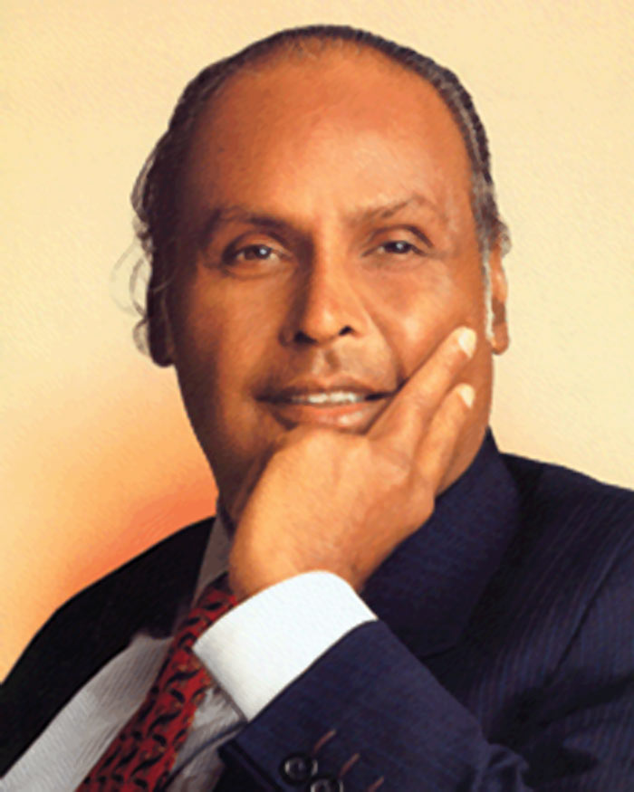
“ Our dreams have to be bigger.
Our ambitions higher.Our
commitment deeper.And our
efforts greate .This is my
Dream for Reliance
And for India. “
--- Dhirubhai Ambani ---

Slide 3
PROJECT - 1 DETAILS
DEVELOPMENT OF UTILITY TOOL TO AUTOMATE
BTAS CDR ANALYSIS
SCRIPTING : BASH

Slide 4

BTAS CDR ANALYSIS
BTAS - Business Telephony Application Server
CDR - Call Detail Recording
CDR
CSV Format
Generates
Call Passes
BTAS
SYSTEM

Slide 5
BTAS SYSTEM
** HAS MULTIPLE CLUSTER
EACH CLUSTER : May be 1 blade , 2 blade or 6 blade setup
C1 & C2 = Controllers ACTIVE OR STANDBY
P1 , P2 ,P3 & P4 = Payloads ACTIVE OR STANDBY
C1 C2 P1 P2 P3 P4

Slide 6

CDR -PHONE NUMBER ANALYSIS WITHOUT AUTOMATION
LOCATION CDR --- > /data1/output/chrg/online/cdrs/
Login , Location
Grep
C1
--------
C2
--------
P1
--------
P2
--------
P3
--------
P4
C1
------ C2
------ P1
------
P2
------ P3
------ P4
C1
------ C2
------ P1
------
P2
------ P3
------ P4
C1
------ C2
------ P1
------
P2
------ P3
------ P4
Call End Time
24 times ssh -->location-->grep phone no.
Cluster1 Cluster2 Cluster3 Cluster4

Slide 7
CDR NUMBER ANALYSIS WITH AUTOMATION
Controller 1
10.64.220.12
-------------------
Controller 2
10.64.220.13
circle_ip_details.txt
10.64.254.4
10.64.220.12
Controller 1
10.64.254.4
rtNumberCircleAnalysis.sh
Start End Phone
CLUSTER 1
CLUSTER 2
FINAL REPORT CLUSTER 1
COPY TO ALL BLADES
rtNumberAnalysis.sh
Final Report : /data1/output/cdr_analysis/number_anasysis/reports
SCRIPT PATH : ~/rtBTAS/AS/scripts/Utility_Scripts/

Slide 8
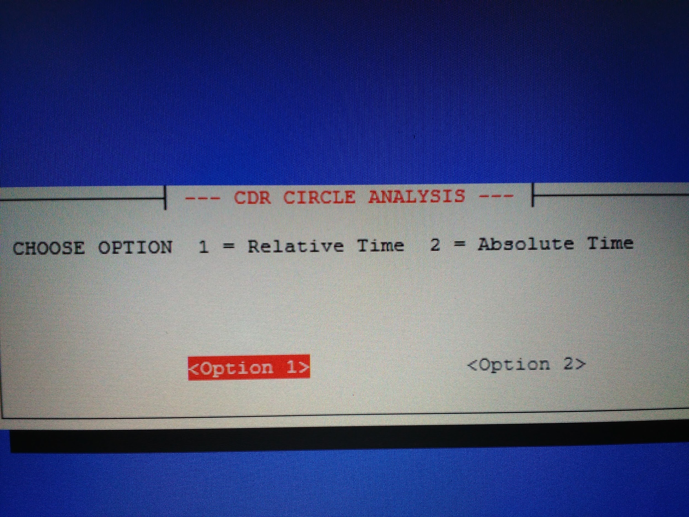
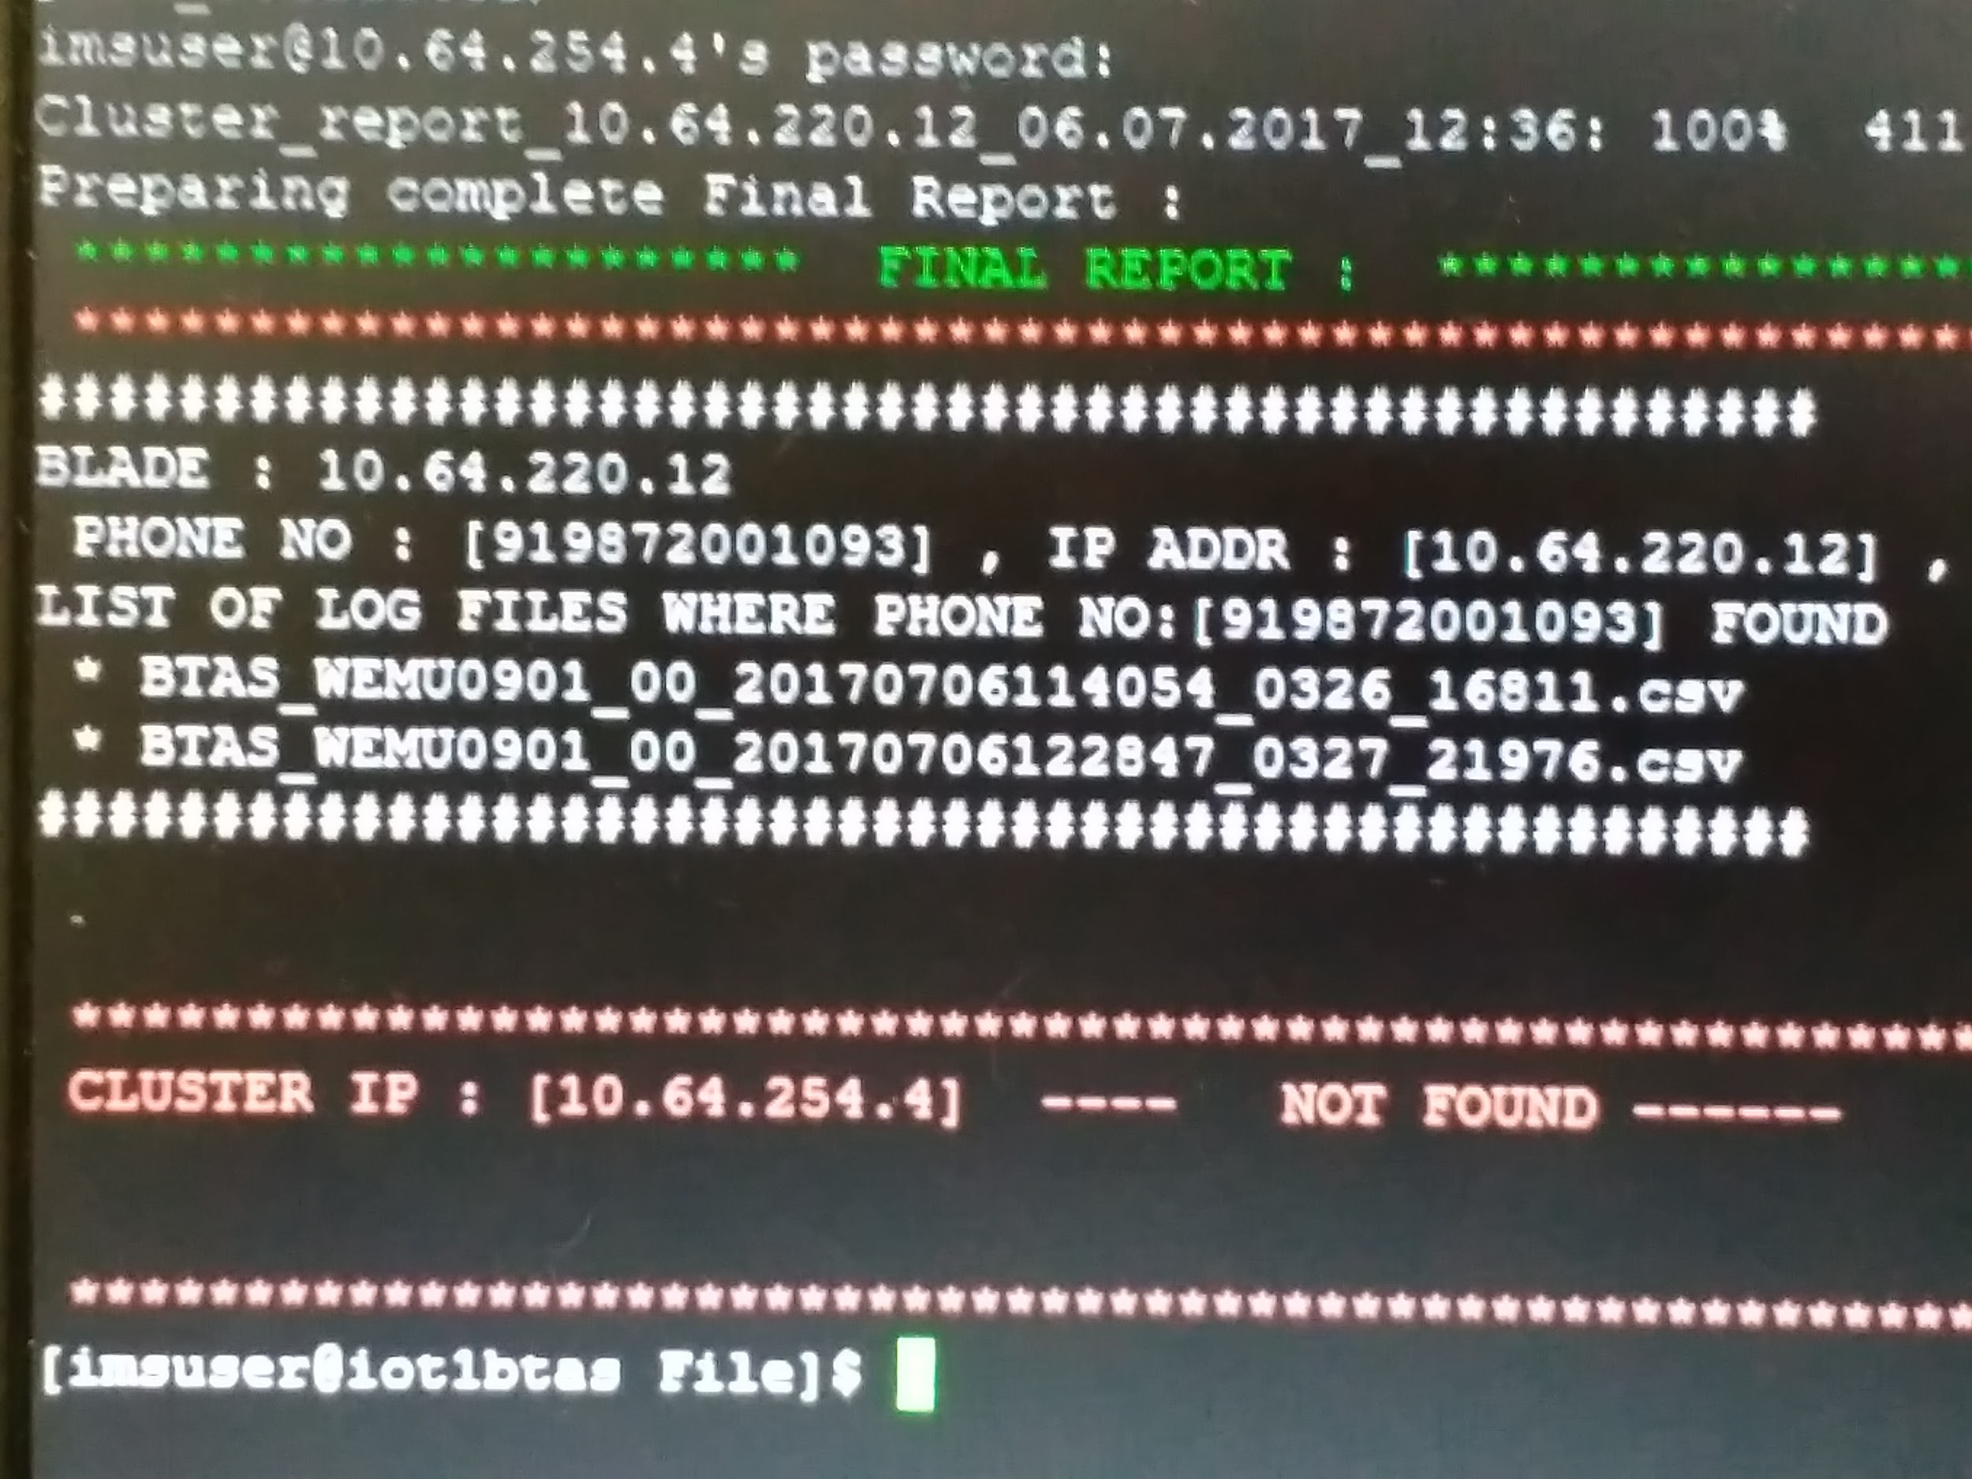

Slide 9
CDR SUCCESS RATE OF CALLS AND FAILURE ERROR CODES ANALYSIS
Controller 1
10.64.220.12
-------------------
Controller 2
10.64.220.13
analysis_circle_ip_details.txt
10.64.254.4
10.64.220.12
Controller 1
10.64.254.4
rtCircleAnalysis.sh
Start End 1/2
CLUSTER 1
CLUSTER 2
FINAL REPORT CLUSTER 1
COPY TO ALL BLADES
rtAnalysis.sh
Final Report : /data1/output/cdr_analysis/performance_anasysis/reports
SCRIPT PATH : ~/rtBTAS/AS/scripts/Utility_Scripts/

Slide 10
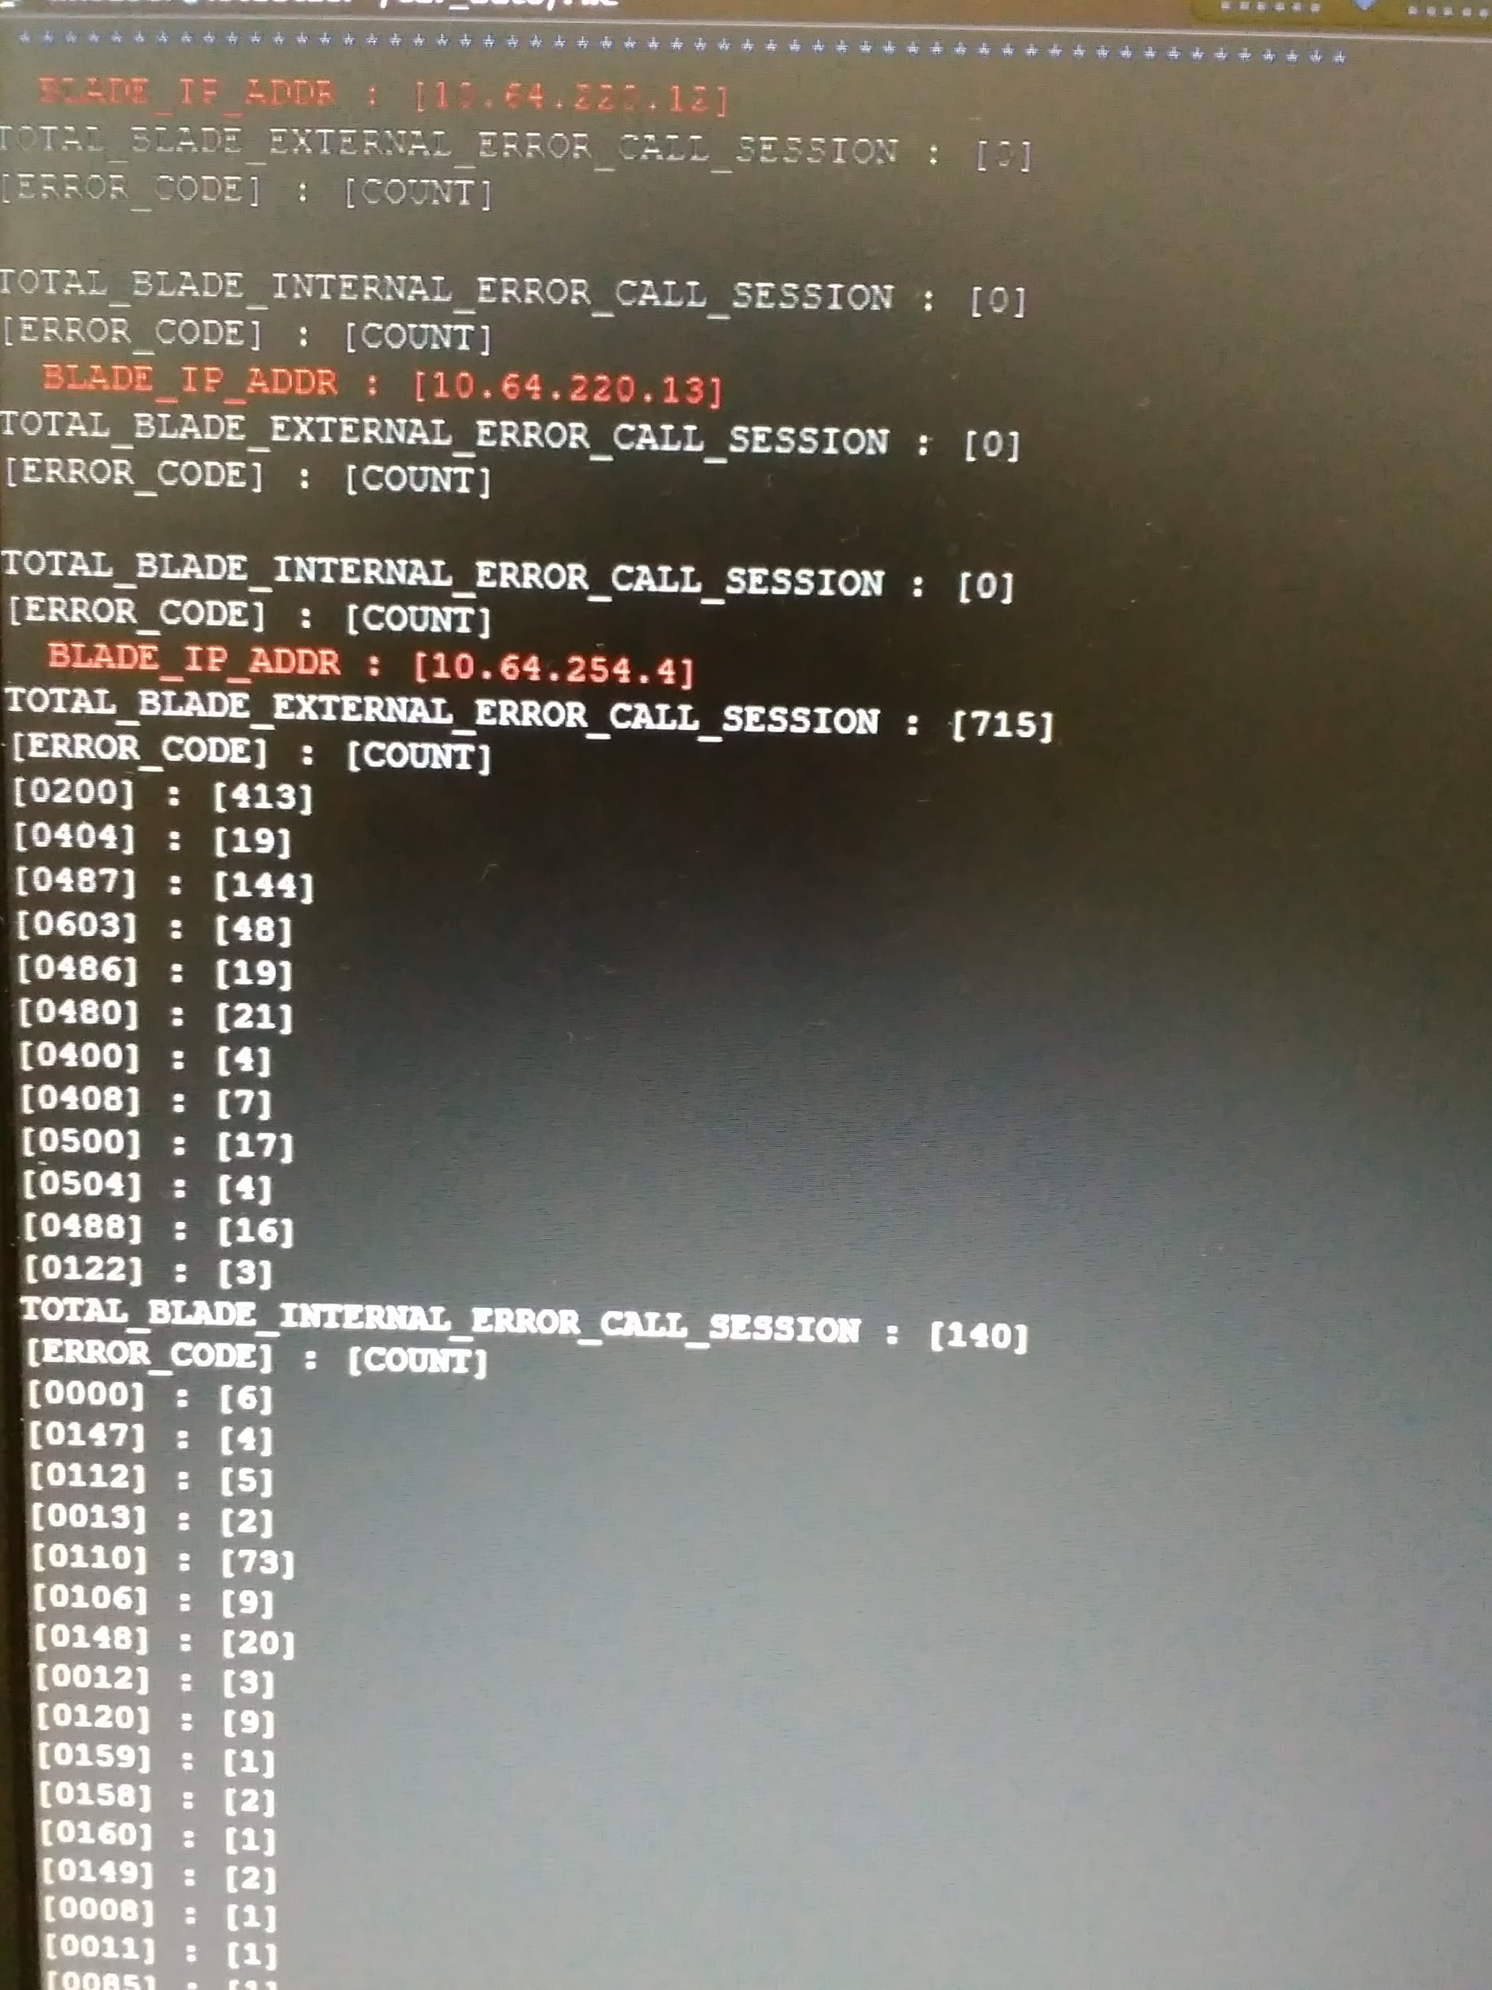
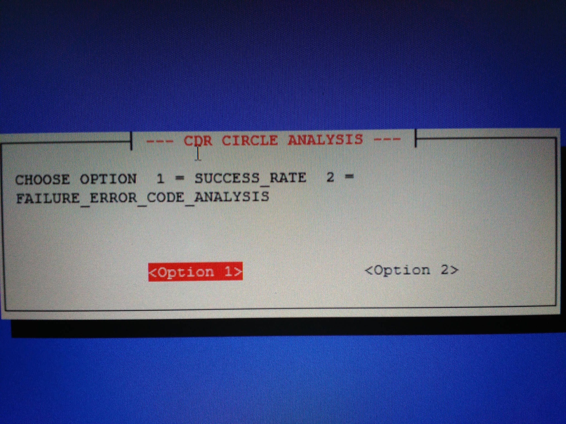

Slide 11
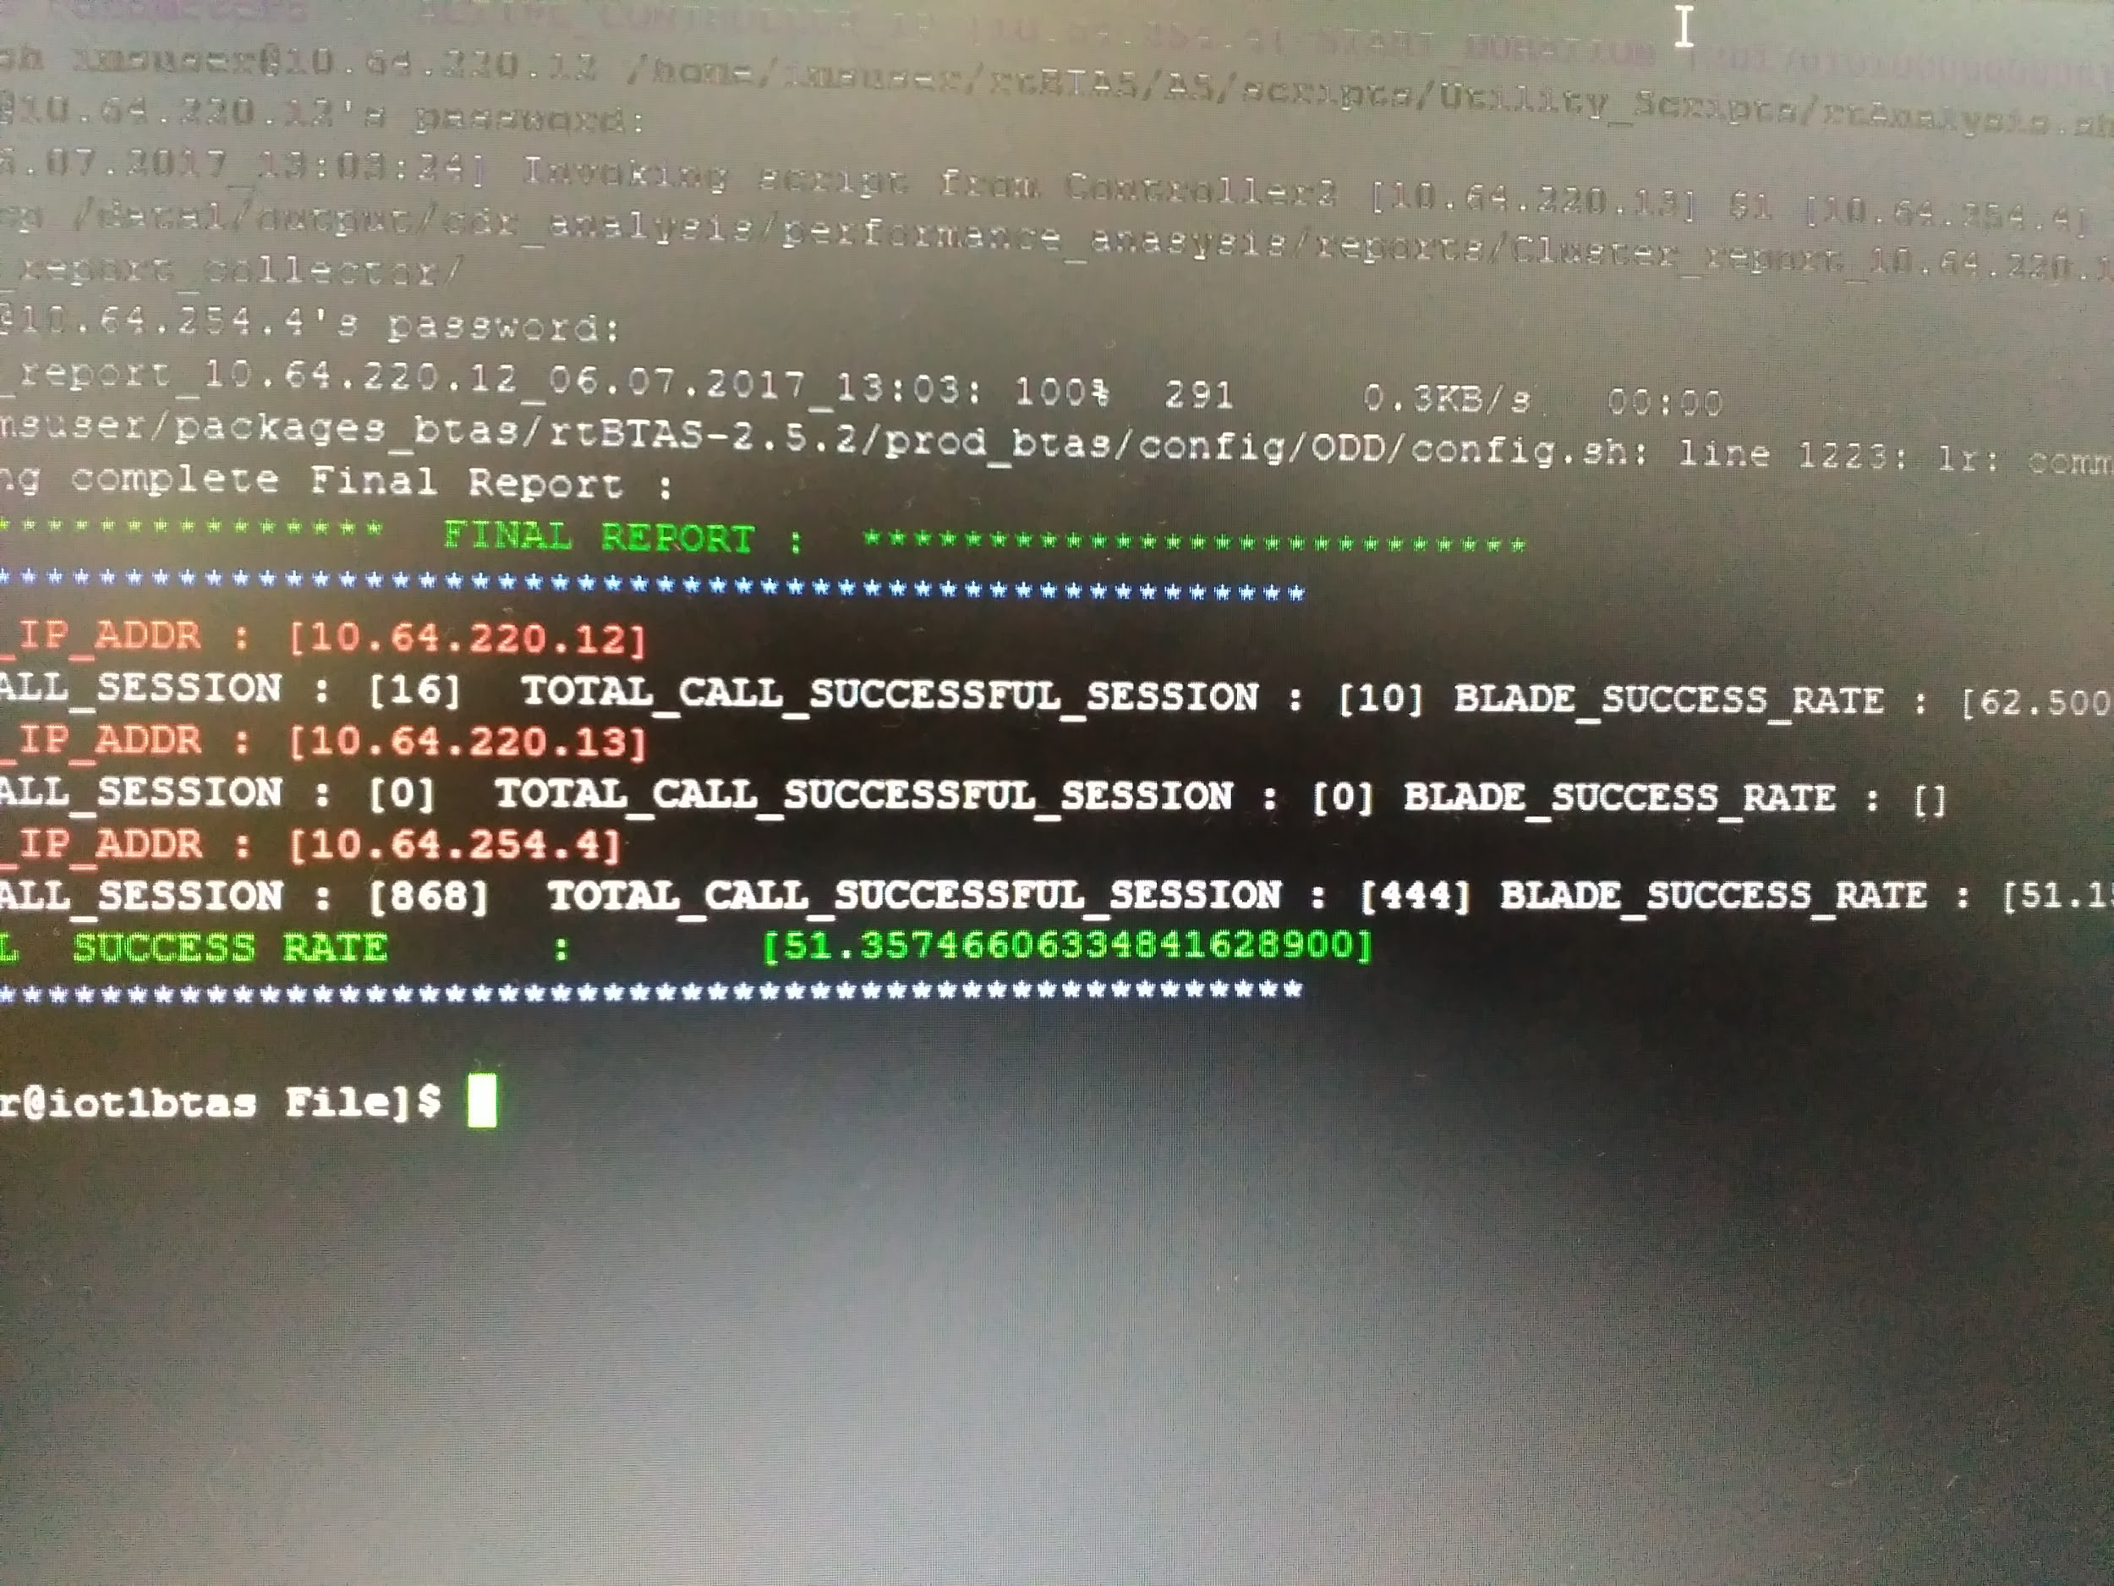
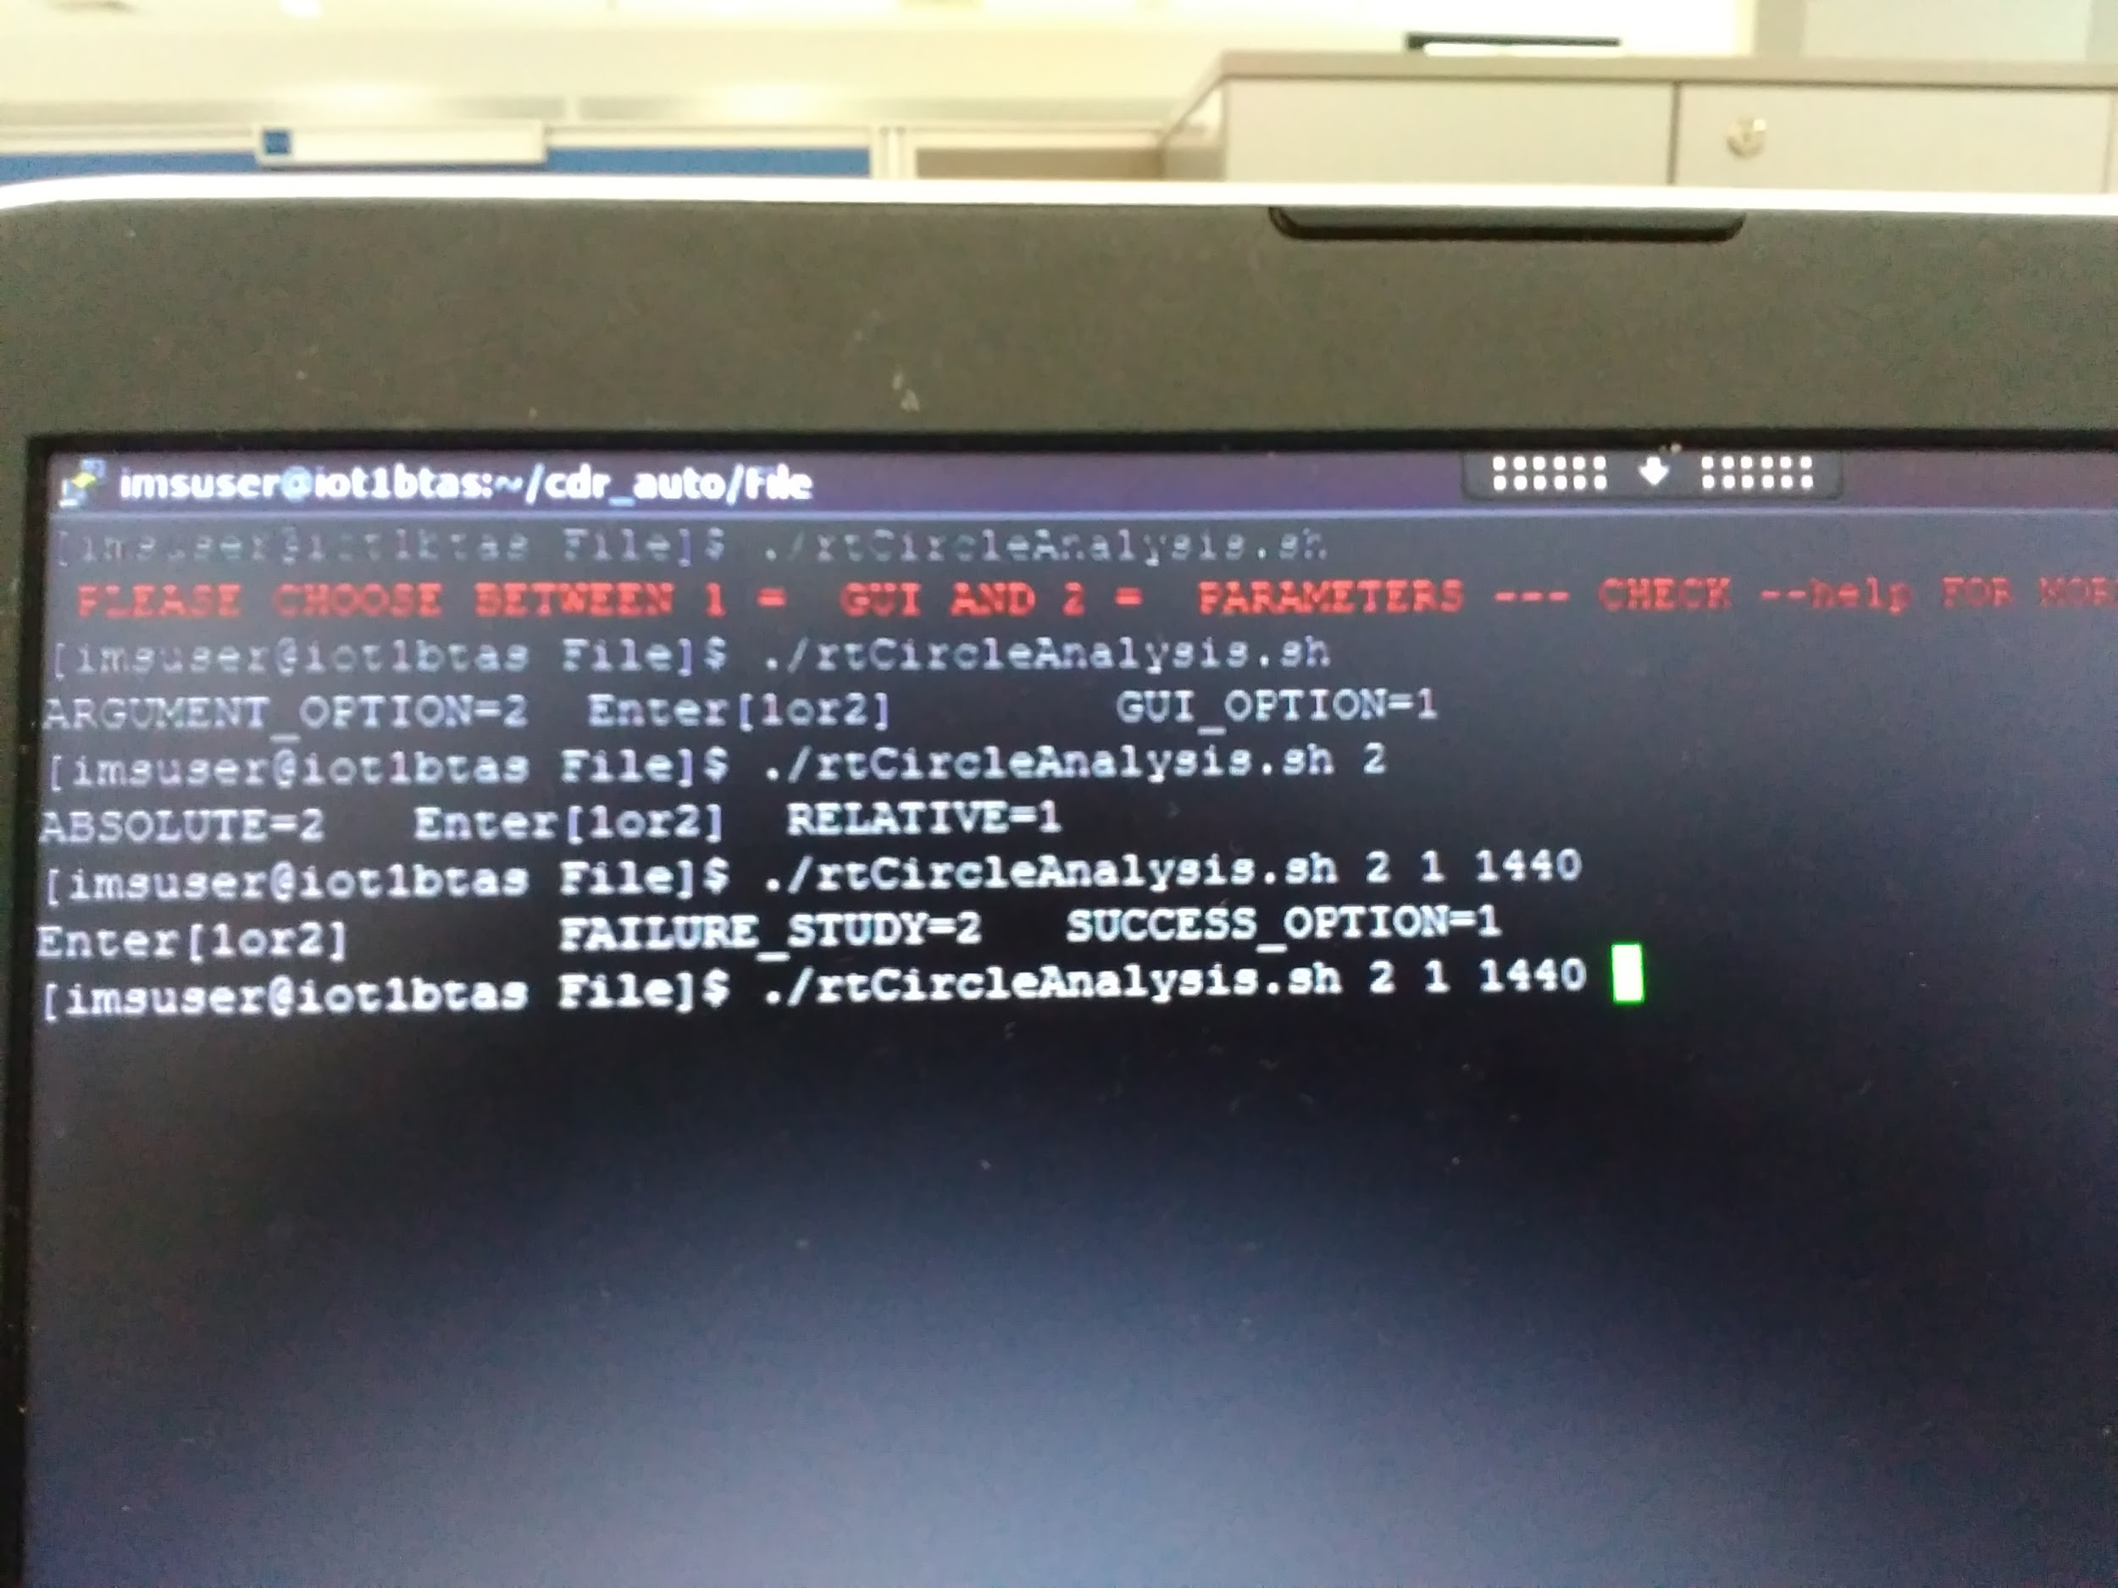
AUTOCOMPLETE HINT FEATURE ON TAB PRESS
Copy rtBashrc.sh to ~/.bashrc
Source ~/.bashrc

Slide 12

PROJECT - 2 DETAILS
UNDERSTANDING FUNCTIONALITY OF
WEBRTC SOCKET.io & SIP
WEBRTC - Web Real Time Communication
SIP - Session Initiation Protocol
Socket.io - Javascript Library for realtime web communication

Slide 13
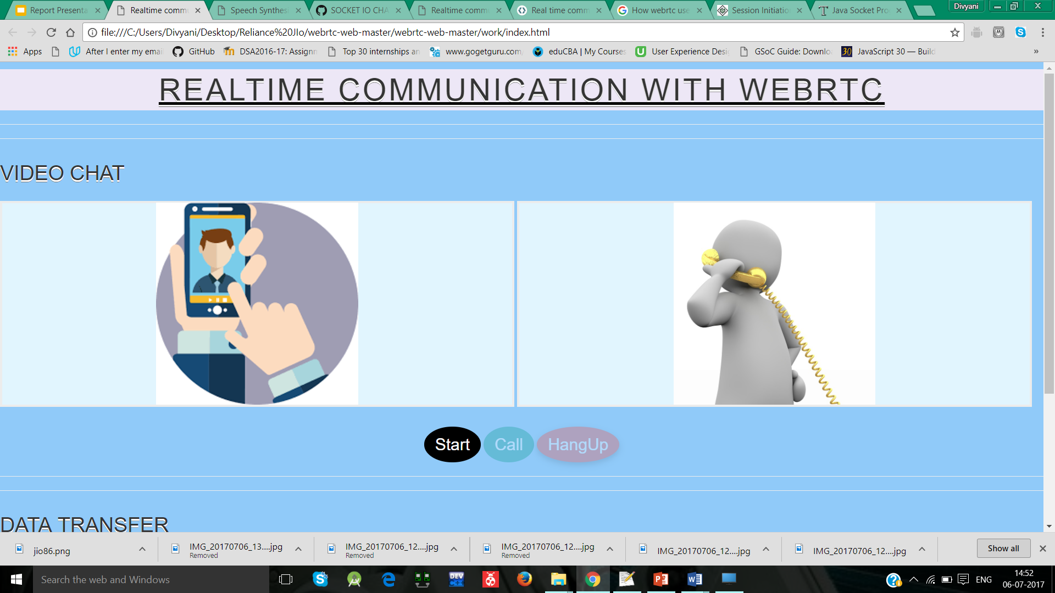
DEMO TO UNDERSTAND WEBRTC

Slide 14
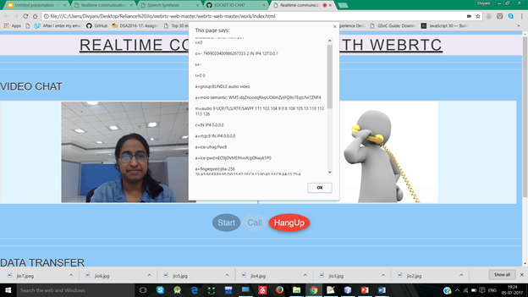

Slide 15
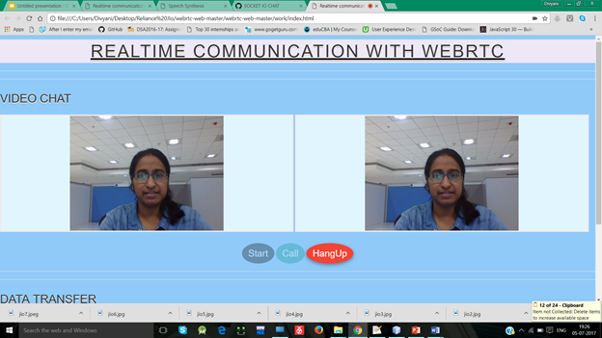

Slide 16
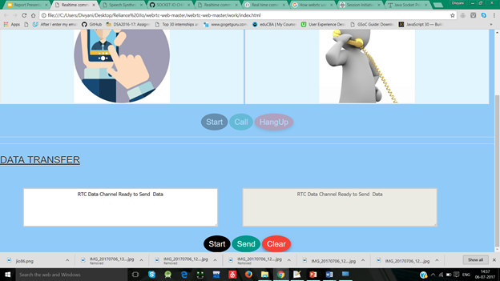
BOTH CLIENT AND SERVER ON SAME MACHINE
DATA TRANSFER USING WebRTC

Slide 17
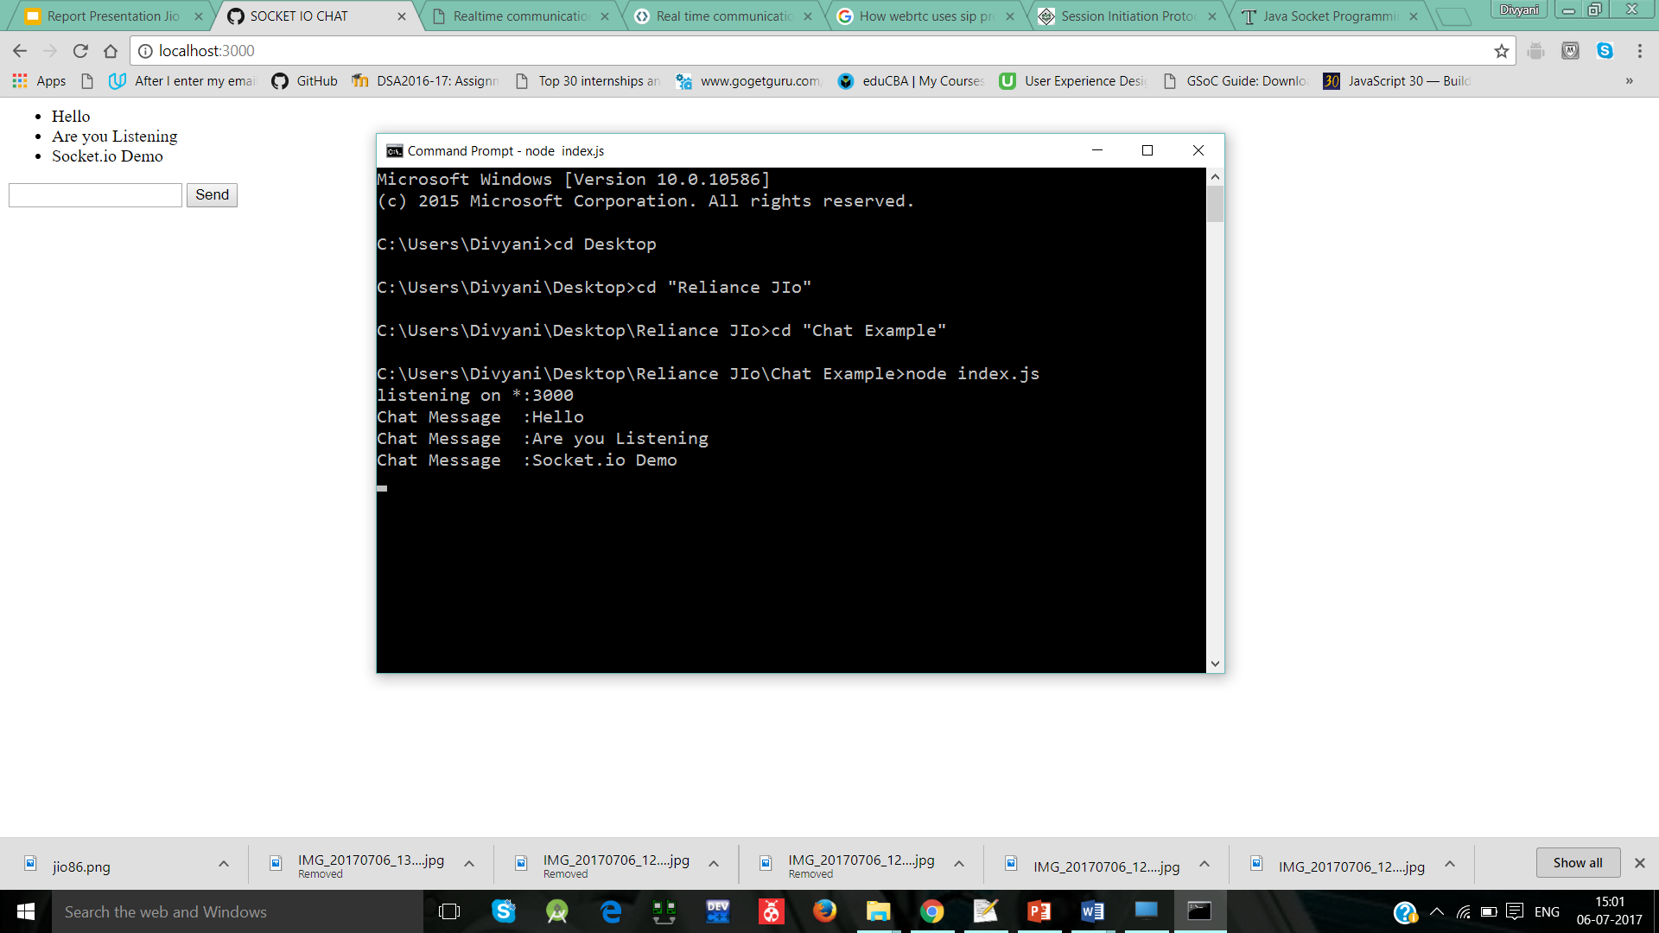
UNDERSTANDING SOCKET.IO DEMO

Slide 18
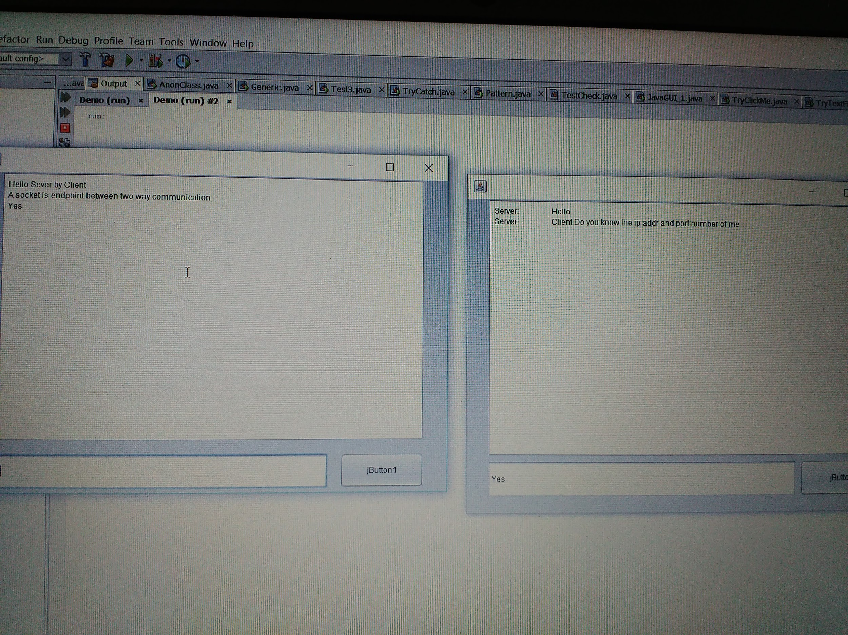
SOCKET UNDERSTANDING IN JAVA DEMO

Slide 19

CONCLUSION :
JIO empowers people to achieve their dreams.
Automate Process to be faster and efficient.
Keep Learning ..
Jio is here don’t fear.

Slide 20

THANKYOU ...

